Slide 1

Introduction to Algorithms
Lecture 3: Unknown Array Size Problem
Yao-Chung Fan
yfan@nchu.edu.tw
Notes:
[wayne s14] I always seem to run over. Consider cutting percolation.
[wayne s14] modified terminology to use connected (instead of find)
[wayne s12] weighted quick union and quick union not identical when two trees have same size. Suggest changing quick union to break ties differently since the demos for weighted quick union would require more work to fix.

Slide 2
Unknown Array Size Problem
Notes:
[wayne s14] I always seem to run over. Consider cutting percolation.
[wayne s14] modified terminology to use connected (instead of find)
[wayne s12] weighted quick union and quick union not identical when two trees have same size. Suggest changing quick union to break ties differently since the demos for weighted quick union would require more work to fix.

Slide 3

Homework Assignment #3
public class DoraemonBag
 | DoraemonBag() | create an empty bag
void | push(String item) | insert a new string onto bag
String | pop() | remove and return the string most recently added
int | size() | number of strings on the can

Slide 4
Unknown Array Size Problem
Linked List Implementation
Resizing Arrays Implementation

Slide 5
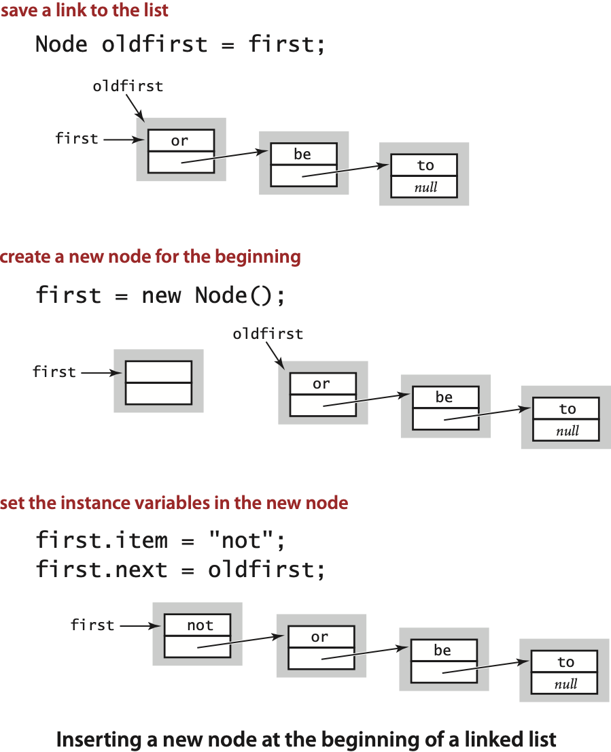
DoraemonBag: linked-list implementation in Java
public class DoraemonBag
{ private Node first = null;
private class Node
{ String item; Node next; }
public void push(String item)
{ Node oldfirst = first; first = new Node(); first.item = item; first.next = oldfirst; }
public String pop()
{ String item = first.item; first = first.next; return item; } }

Slide 6
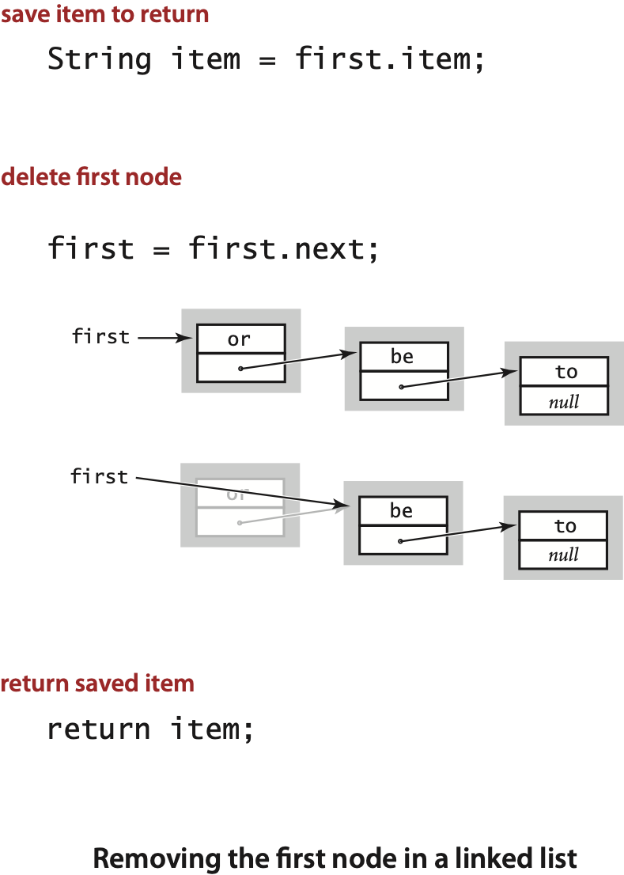
DoraemonBag: linked-list implementation in Java
public class DoraemonBag
{ private Node first = null;
private class Node
{ String item; Node next; }
public void push(String item)
{ Node oldfirst = first; first = new Node(); first.item = item; first.next = oldfirst; }
public String pop()
{ String item = first.item; first = first.next; return item; } }

Slide 7
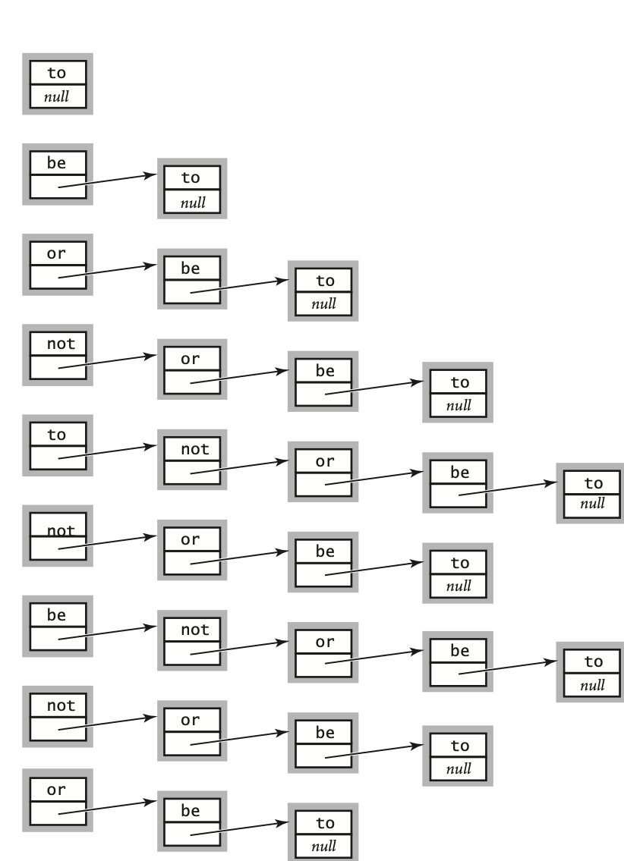
DoraemonBag: linked-list representation
Maintain pointer to first node in a linked list; insert/remove from front.
push("to")
push("be")
push("or")
push("not")
push("to")
pop()
push("be")
pop()
pop()
first
insert at front
of linked list
remove from front
of linked list
Notes:
Need to maintain only one pointer to do efficiently.

Slide 8
Unknown Array Size Problem
Linked List Implementation
Resizing Arrays Implementation

Slide 9
DoraemonBag: resizing-array implementation
private String[];
private int N = 0;
public DoraemonBag()
{ s = new String[1]; }
public void push(String item)
{
if(N==s.length)
resize(s.length+1);
s[N++] = item;
}
private void resize(int capacity) { String[] copy = new String[capacity]; for (int i = 0; i < N; i++) copy[i] = s[i]; s = copy; }
Notes:
can set initial capacity to something other than 2, say 8;
we use 2 because a 0-item stack will be backed by array of size 2
k array accesses to double to size k (not including any cost of creating the new array) because need to copy k/2 items from old array to new array

Slide 10
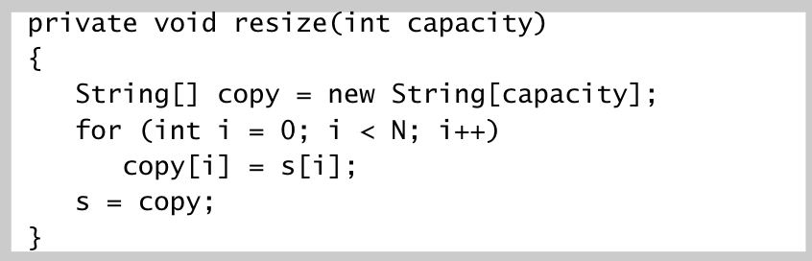
DoraemonBag: resizing-array implementation
Problem. Requiring client to provide capacity does not implement API!
Q. How to grow and shrink array?
First try.
push(): increase size of array s[] by 1.
pop(): decrease size of array s[] by 1.
Too expensive.
Need to copy all items to a new array, for each operation.
Array accesses to insert first N items = N + (2 + 4 + 6 + 8… + 2(N – 1)) ~ N ².
Challenge. Ensure that array resizing happens infrequently.
infeasible for large N
1 array access
per push
2(k–1) array accesses to expand to size k
(ignoring cost to create new array)
Notes:
why do we need to shrink the array? O/w it stays big even when the stack is small.

Slide 11
DoraemonBag: resizing-array implementation
"repeated doubling"
Q. How to grow array?
A. If array is full, create a new array of twice the size, and copy items.
Array accesses to insert first N = 2^{i} items. N + (2 + 4 + 8 + … + N) ~ 3N.
public DoraemonBag()
{ s = new String[1]; }
public void push(String item)
{
if (N == s.length) resize(2 * s.length);
s[N++] = item;
}
private void resize(int capacity) { String[] copy = new String[capacity]; for (int i = 0; i < N; i++) copy[i] = s[i]; s = copy; }
1 array access
per push
k array accesses to double to size k
(ignoring cost to create new array)
Notes:
can set initial capacity to something other than 2, say 8;
we use 2 because a 0-item stack will be backed by array of size 2
k array accesses to double to size k (not including any cost of creating the new array) because need to copy k/2 items from old array to new array

Slide 12
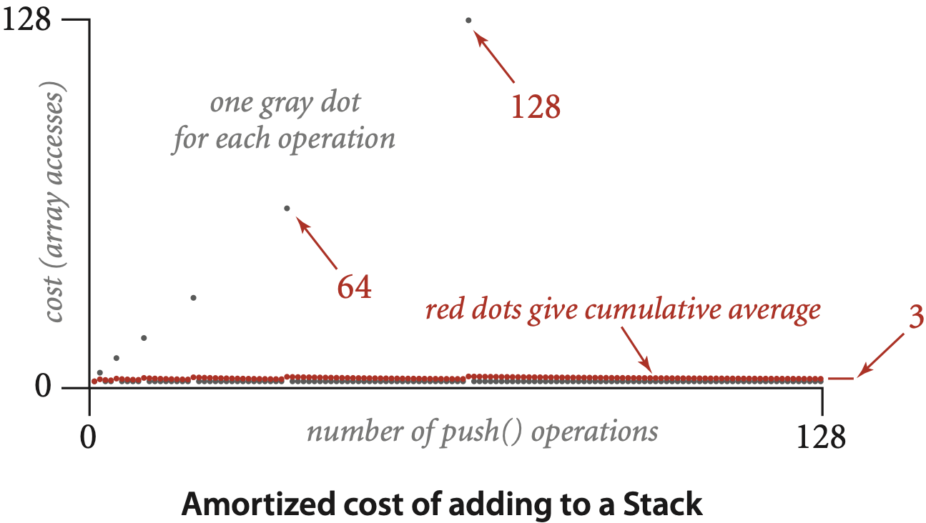
DoraemonBag: amortized cost of adding to a stack
Cost of inserting first N items. N + (2 + 4 + 8 + … + N) ~ 3N.
1 array access
per push
k array accesses to double to size k
(ignoring cost to create new array)
Notes:
k array accesses to double to size k (not including any cost of creating the new array) because need to copy k/2 items from old array to new array

Slide 13
DoraemonBag: resizing-array implementation
Q. How to shrink array?
First try.
push(): double size of array s[] when array is full.
pop(): halve size of array s[] when array is one-half full.
Too expensive in worst case.
Consider push-pop-push-pop-… sequence when array is full.
Each operation takes time proportional to N.
N = 5
to | be | or | not | to | null | null | null
N = 4
to | be | or | not
N = 5
to | be | or | not | to | null | null | null
N = 4
to | be | or | not

Slide 14
DoraemonBag: resizing-array implementation
Q. How to shrink array?
Efficient solution.
push(): double size of array s[] when array is full.
pop(): halve size of array s[] when array is one-quarter full.
Invariant. Array is between 25% and 100% full.
public String pop() {
String item = s[--N];
s[N] = null;
if (N > 0 && N == s.length/4) resize(s.length/2);
return item;
}
Notes:
not (N == s.length / 2) to avoid thrashing
need (N > 0) to prevent array from shrinking to size 0.
Note: a 0-element stack will have size = 2

Slide 15
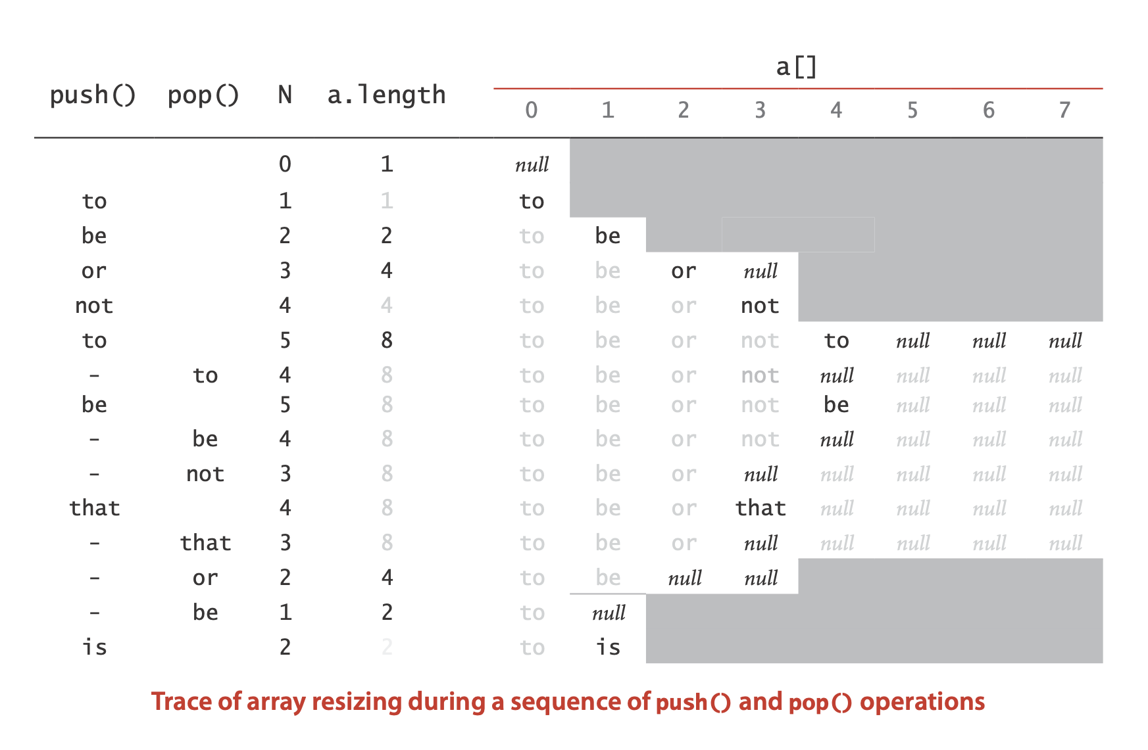
DoraemonBag: resizing-array implementation trace

Slide 16
DoraemonBag resizing-array implementation: performance
Amortized analysis. Starting from an empty data structure, average running time per operation over a worst-case sequence of operations.
Proposition. Starting from an empty stack, any sequence of N push and pop operations takes time proportional to N.
 | best | worst | amortized
construct | 1 | 1 | 1
push | 1 | N | 1
pop | 1 | N | 1
doubling and
halving operations
order of growth of running time for resizing stack with N items
Notes:
Note: important to start from empty data structure; otherwise can choose M = 1.
In fact, almost every thing you do in Java has an amortized running time (and not a worst-case running time) because of garbage collection.
Real-time Java does provide guarantees for garbage collection, class loading, Just-in-time compilation, and thread scheduling.

Slide 17
Which one is better?
public class DoraemonBag
{ private Node first = null;
private class Node
{ String item; Node next; }
public void push(String item)
{ Node oldfirst = first; first = new Node(); first.item = item; first.next = oldfirst; }
public String pop()
{ String item = first.item; first = first.next; return item; } }
public class DoraemonBag
{
public DoraemonBag()
{ s = new String[1]; }
private void resize(int capacity) { String[] copy = new String[capacity]; for (int i = 0; i < N; i++) copy[i] = s[i]; s = copy; }
public void push(String item)
{
if (N == s.length) resize(2 * s.length);
s[N++] = item;
}
public String pop() {
String item = s[--N];
s[N] = null;
if (N > 0 && N == s.length/4) resize(s.length/2);
return item;
}
}

Slide 18
Stack implementations: resizing array vs. linked list
Tradeoffs. Can implement a stack with either resizing array or linked list; client can use interchangeably. Which one is better?
Linked-list implementation.
Every operation takes constant time in the worst case.
Uses extra time and space to deal with the links.
Resizing-array implementation.
Every operation takes constant amortized time.
Less wasted space.
N = 4
to | be | or | not | null | null | null | null
???
Notes:
no clear winner – always tradeoffs

Slide 19

Stack implementations: resizing array vs. linked list
Tradeoffs.
Can implement a stack with either resizing array or linked list; client can use interchangeably.
Which one is better?
Notes:
no clear winner – always tradeoffs

Slide 20
Analysis of Algorithms
memory analysis

Slide 21
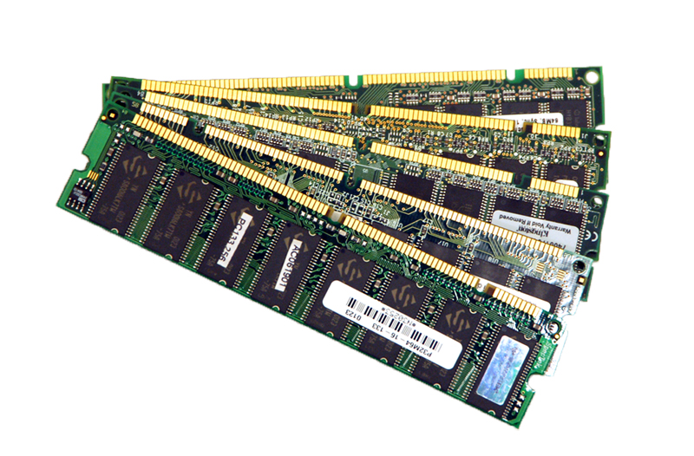

Basics
Bit. 0 or 1.
Byte. 8 bits.
Megabyte (MB). 1 million or 2²⁰ bytes.
Gigabyte (GB). 1 billion or 2³⁰ bytes.
64-bit machine. We assume a 64-bit machine with 8-byte pointers.
Can address more memory.
Pointers use more space.
NIST
most computer scientists
some JVMs "compress" ordinary object
pointers to 4 bytes to avoid this cost
Notes:
surprising that there is controversy about even these basic definitions
NIST standard: GB = 1 billion bytes, MB = 1 million bytes; gibibyte (GiB) = 2^30 bytes, mebibyte (MiB) = 2^20 bytes
RAM is measured in binary GB whereas hard drive memory is measured in decimal GB
oops = ordinary object pointers
Compressed oops. Some JVMs attempt to "compress" ordinary object pointers to 4 bytes.

Slide 22
Typical memory usage for primitive types and arrays
Primitive types. Array overhead. 24 bytes.
type | bytes
boolean | 1
byte | 1
char | 2
int | 4
float | 4
long | 8
double | 8
type | bytes
char[] | 2 N + 24
int[] | 4 N + 24
double[] | 8 N + 24
one-dimensional arrays
type | bytes
char[][] | ~ 2 M N
int[][] | ~ 4 M N
double[][] | ~ 8 M N
primitive types
two-dimensional arrays
Notes:
array overhead = 24 bytes
table contains typical memory requirements for primitive types - boolean use 1 byte (not 1 bit).
In C, char typically uses 1 byte; in Java it is 2 bytes for Unicode.
2d array is represented as an array of arrays: e.g., for double[][], there is one array with N references to arrays (4N + 16) and N double[] arrays (N (8N + 16)) for a total of 8N^2 + 20N + 16 bytes.

Slide 23
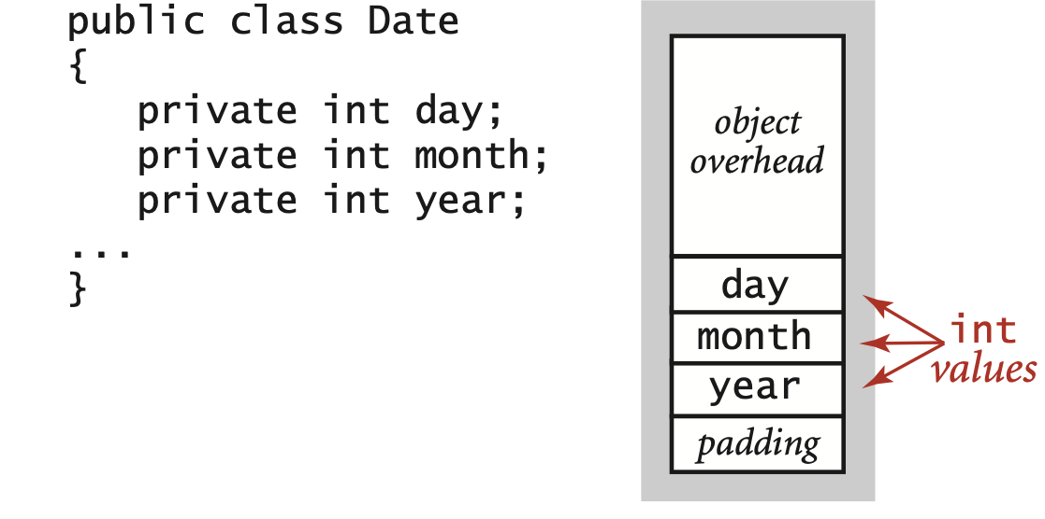
Typical memory usage for objects in Java
Object overhead. 16 bytes.
Reference. 8 bytes.
Padding. Each object uses a multiple of 8 bytes.
Ex 1. A Date object uses 32 bytes of memory.
16 bytes (object overhead)
4 bytes (int)
4 bytes (int)
4 bytes (int)
4 bytes (padding)
32 bytes

Slide 24
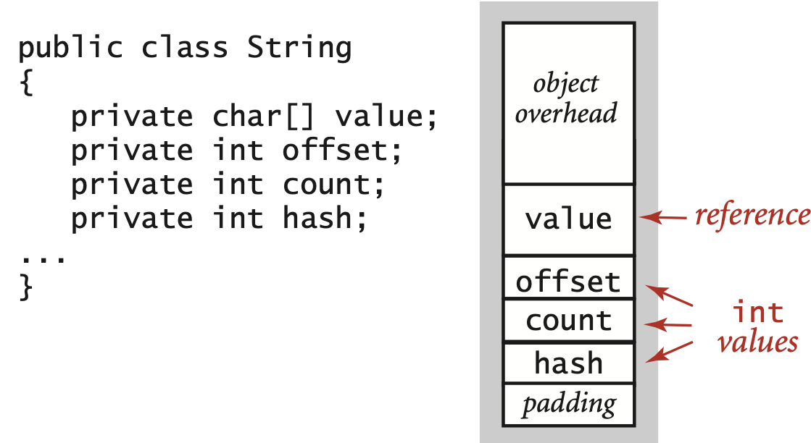
Typical memory usage for objects in Java
Object overhead. 16 bytes.
Reference. 8 bytes.
Padding. Each object uses a multiple of 8 bytes.
Ex 2. A virgin String of length N uses ∼ 2N bytes of memory.
16 bytes (object overhead)
8 bytes (reference to array)
2N + 24 bytes (char[] array)
4 bytes (int)
4 bytes (int)
4 bytes (int)
4 bytes (padding)
2N + 64 bytes

Slide 25
Typical memory usage summary
Total memory usage for a data type value:
Primitive type: 4 bytes for int, 8 bytes for double, …
Object reference: 8 bytes.
Array: 24 bytes + memory for each array entry.
Object: 16 bytes + memory for each instance variable.
Padding: round up to multiple of 8 bytes.
Shallow memory usage: Don't count referenced objects.
Deep memory usage: If array entry or instance variable is a reference,
count memory (recursively) for referenced object.
+ 8 extra bytes per inner class object
(for reference to enclosing class)
Notes:
[wayne s14] inner class = non-static nested class
[wayne] build shallow and deep

Slide 26
Memory profiler
Classmexer library. Measure memory usage by querying JVM.
http://www.javamex.com/classmexer
import com.javamex.classmexer.MemoryUtil;
public class Memory {
public static void main(String[] args) {
Date date = new Date(12, 31, 1999);
StdOut.println(MemoryUtil.memoryUsageOf(date));
String s = "Hello, World";
StdOut.println(MemoryUtil.memoryUsageOf(s));
StdOut.println(MemoryUtil.deepMemoryUsageOf(s));
}
}
shallow
deep
% javac -cp .:classmexer.jar Memory.java
% java -cp .:classmexer.jar -javaagent:classmexer.jar Memory
32
40
88
don't count char[]
use -XX:-UseCompressedOops
on OS X to match our model
2N + 64
Notes:
N = 12 for "Hello World"

Slide 27
Example
Q. How much memory does WeightedQuickUnionUF use as a function of N ?
Use tilde notation to simplify your answer.
A. 8 N + 88 ~ 8 N bytes.
public class WeightedQuickUnionUF
{
private int[] id;
private int[] sz;
private int count;
public WeightedQuickUnionUF(int N)
{
id = new int[N];
sz = new int[N];
for (int i = 0; i < N; i++) id[i] = i;
for (int i = 0; i < N; i++) sz[i] = 1;
}
...
}
16 bytes
(object overhead)
8 + (4N + 24) bytes each
(reference + int[] array)
4 bytes (int)
4 bytes (padding)
8N + 88 bytes
Notes:
When N is large, the only thing we care about are the two int arrays, each of size N.
A. 8N + 88 ~ 8N bytes
- 16 bytes object overhead
- 8 + 8 + 4 bytes for instance variables (two references to arrays and int)
- 4 bytes padding
- 8N + 48 (two int[] arrays of size N, which are 2N + 24 each)

Slide 28
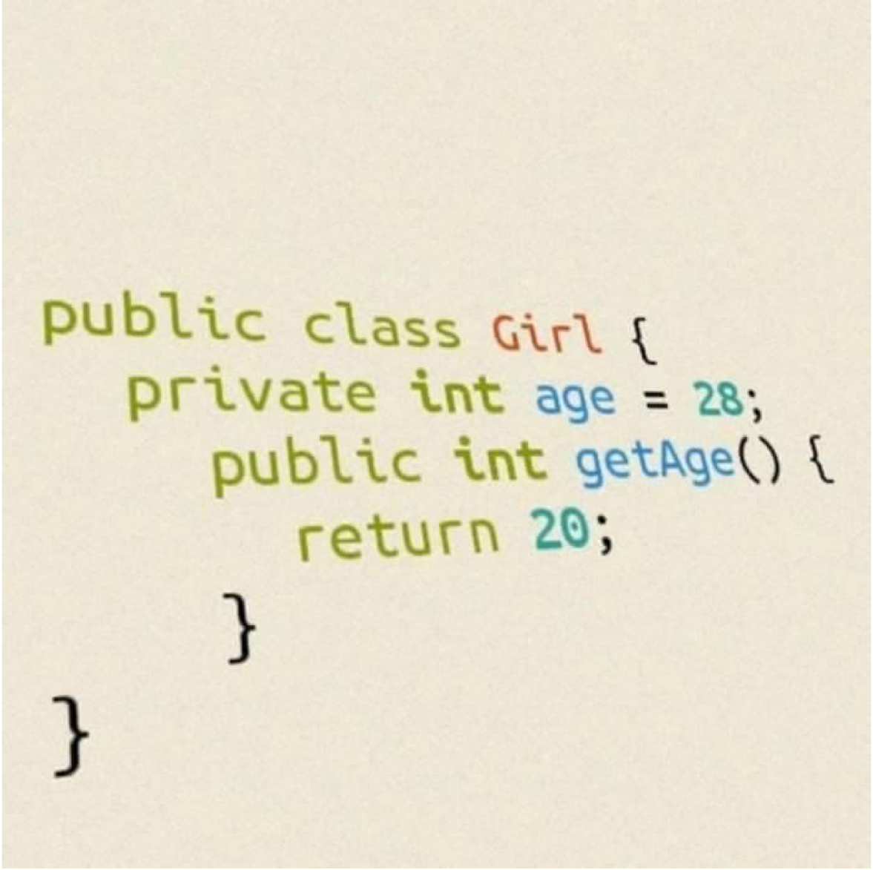
How much memory is required by the following object?

Slide 29
Which one is better?
public class DoraemonBag
{ private Node first = null;
private class Node
{ String item; Node next; }
public void push(String item)
{ Node oldfirst = first; first = new Node(); first.item = item; first.next = oldfirst; }
public String pop()
{ String item = first.item; first = first.next; return item; } }
public class DoraemonBag
{
public DoraemonBag()
{ s = new String[1]; }
private void resize(int capacity) { String[] copy = new String[capacity]; for (int i = 0; i < N; i++) copy[i] = s[i]; s = copy; }
public void push(String item)
{
if (N == s.length) resize(2 * s.length);
s[N++] = item;
}
public String pop() {
String item = s[--N];
s[N] = null;
if (N > 0 && N == s.length/4) resize(s.length/2);
return item;
}
}

Slide 30
Stack DoraemonBag_Resizing_Array implementation: Memory Usage
Q. How much memory does a ResizingArrayImplementation use to store N strings in the best case? Worst case?
Count only the memory owned by the stack (not the strings themselves).
Notes:
~N, ~4N, ~8N, ~16N, ~32N

Slide 31
DoraemonBag_Resizing_Array implementation: memory usage
Proposition. Uses between ~ 8 N and ~ 32 N bytes to represent a stack with N items.
~ 8 N when full.
~ 32 N when one-quarter full.
public class DoraemonBagResizingArray { private String[] s; private int N = 0;
…
}
8 bytes × array size

Slide 32
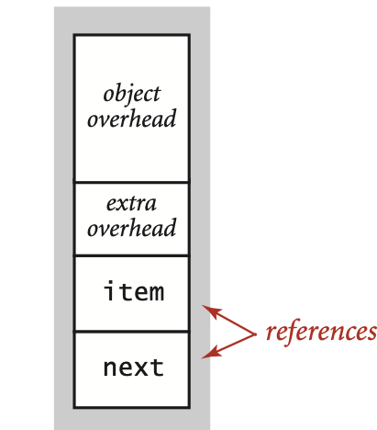
Stack: linked-list implementation performance
Proposition. Every operation takes constant time in the worst case.
Proposition. A stack with N items uses ∼ 40 N bytes.
inner class
16 bytes (object overhead)
private class Node
{
String item;
Node next;
}
8 bytes (inner class extra overhead)
8 bytes (reference to String)
8 bytes (reference to Node)
40 bytes per stack node
Notes:
Note: nested class Node could be static here (and avoid 8 byte penalty for inner class), but we'll need it to be non-static when we introduce generics.
inner class includes pointer to enclosing instance

Slide 33
Something You Need to Know Object Loitering
public class DoraemonBag_Resizing_Array
{ private Node first = null;
private class Node
{ String item; Node next; }
public boolean isEmpty()
{ return first == null; }
public void push(String item)
{ Node oldfirst = first; first = new Node(); first.item = item; first.next = oldfirst; }
public String pop()
{ String item = first.item; first = first.next; return item; } }
Loitering. Holding a reference to an object when it is no longer needed.

Slide 34
Client, Implementation, Interface
Separate interface and implementation. Ex: stack, queue, bag, priority queue, symbol table, union-find, .…
Benefits.
Client can't know details of implementation ⇒ client has many implementation from which to choose.
Implementation can't know details of client needs ⇒ many clients can re-use the same implementation.
Design: creates modular, reusable libraries.
Performance: use optimized implementation where it matters.
Client: program using operations defined in interface.
Implementation: actual code implementing operations.
Interface: description of data type, basic operations.
Notes:
decouple implementation from client
Build layers of abstraction.

Slide 35
Java collections library
List interface. java.util.List is API for an sequence of items.
https://docs.oracle.com/javase/7/docs/api/index.html?java/util/package-tree.html
public interface List<Item> implements Iterable<Item>
 | List() | create an empty list
boolean | isEmpty() | is the list empty?
int | size() | number of items
void | add(Item item) | append item to the end
Item | get(int index) | return item at given index
Item | remove(int index) | return and delete item at given index
boolean | contains(Item item) | does the list contain the given item?
Iterator<Item> | iterator() | iterator over all items in the list
...
?
java.util.ArrayList
java.util.LinkedList
implementation
implementation

Slide 36
Which one is better ? What is the difference ?
java.util.ArrayList
v.s.
java.util.LinkedList

Slide 37

Java collections library
Lesson. Don't use a library until you understand its API!
List interface. java.util.List is API for an sequence of items.
Implementations. java.util.ArrayList uses resizing array; java.util.LinkedList uses linked list.
public interface List<Item> implements Iterable<Item>
 | List() | create an empty list
boolean | isEmpty() | is the list empty?
int | size() | number of items
void | add(Item item) | append item to the end
Item | get(int index) | return item at given index
Item | remove(int index) | return and delete item at given index
boolean | contains(Item item) | does the list contain the given item?
Iterator<Item> | iterator() | iterator over all items in the list
...

Slide 38


